Slide 1
Project Skylight
A Smartlamp Providing Clarity
Eric Brauer
eric.m.brauer@gmail.com
Notes:
Hell and welcome to my presentation. My name is Eric Brauer and today I would like to demonstrate my TPJ project and talk a little about what it can offer.

Slide 2
Agenda:
What is it?
Why?
Demo
Features
Technical Overview
Where to go from here
Notes:
And just to talk about how this presentation is going to be structured: I will start by explaining what Project Skylight is and what it was meant to accomplish. After that I will walk you through the process of setting it up, and then into more detail about how it works.

Slide 3
Project Skylight is an Internet-Connected Lamp.
Notes:
Basically, Project Skylight is an internet-connected lamp that simulates the time of day. This being Toronto, it goes without saying that the cost of living is high, and a lot of people find themselves living in basement apartments.

Slide 4

A view of the outside world.
Notes:
An exterior window can quickly give you a visual reference to the time of day, and I think it’s something that we take for granted. I know that whenever I’ve been in rooms without external windows, it can be a disorienting experience. If you are trying to maintain a natural sleeping pattern, It can be hard to wake up without daylight, and when you do so it can often be disorienting and uncomfortable.

Slide 5
Addressing the Problem of Disorientation.
Simple, and Cost-efficient.
Notes:
I think that having a visual reference to the outside world is something that’s very primal and natural for us humans. And that is what the Skylight is meant to provide: a simulated visual reference to the time of day. It’s meant to brighten a room in the morning, and let people know when it’s getting dark out. In addition, I thought about the people who might be interested in such a product. They aren’t necessarily tech enthusiasts, and don’t necessarily have a huge amount of disposable income. In thinking about this demographic, I formulated some other goals for the project: I wanted it to be simple to set up, and mostly autonomous, and under 50 dollars. This is meant to be a solution for everyday people, not just tech enthusiasts.

Slide 6
Demonstration:
Notes:
And so, to demonstrate that, I would like to now go through the process of setting up the Skylight for the first time. The Skylight takes any standard micro-USB adapter for power. The first time it starts up, it will need to get connected to a wifi Access Point. Since it doesn’t know where to connect, it will start in Station mode. I will use my laptop to connect to ‘SKYLIGHT’, where I can enter my credentials.

Slide 7
Demonstration:
Notes:
I’m using my phone as a hotspot for this demonstration. Once I have entered the correct credentials, the Skylight will download time of day information and get the correct time. And it should understand that we are in the middle of the day, and set the lights accordingly.

Slide 8
Demonstration:
Notes:
Now that we’ve connected to an Access Point, the skylight will remember the credentials and attempt to connect to it on startup. And now to Control the skylight, we can connect to the same access point as the skylight, and navigate to ‘skylight.local.’

Slide 9
The GUI.
Notes:
And now we have some options to control the Skylight. These are pretty basic, as I wanted to limit the scope of the project as much as possible. But I can easily show you what a dawn or dusk transition looks like in fast forward. (Run the demo). In addition, I can set a manual time for the transition to occur. And the skylight should try and simulate that.

Slide 10
Features of the Skylight:
Connects to NTP for proper time
Downloads the Time of Day
Uses LEDs to simulate the sky
Serves a web interface to control some features
A knob controls brightness
Notes:
And that, essentially, is the what the project is about. With a quick glance, you can see if it’s daytime, if it’s night, and get a feel for the time in a way that should feel very intuitive. And without a lot of complexity or set up.

Slide 11
Technical Specifications
Notes:
I would like to now discuss some of the technical details of the project, but does anybody have any questions so far?

Slide 12
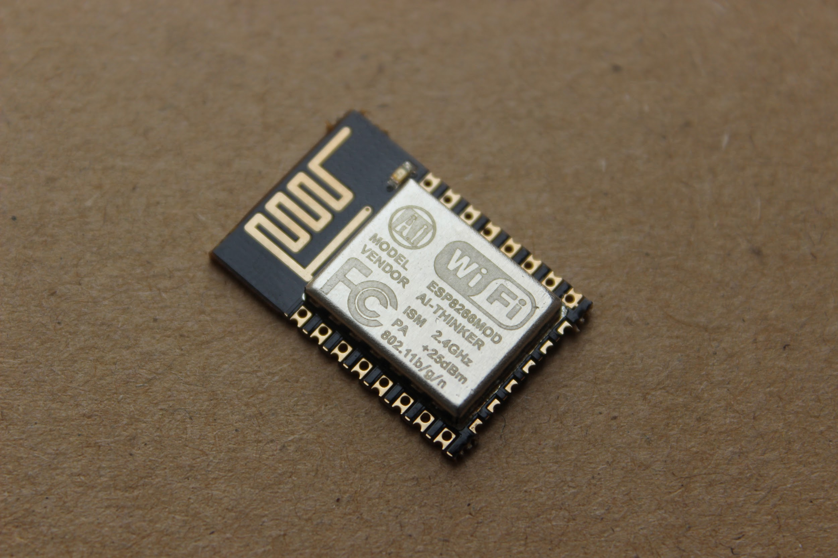
Hardware: MCU/WiFi Module https://hackaday.com/tag/esp-12/ for ideas
Notes:
The main hardware component of the Skylight is a combination microcontroller/WiFi module called the ESP-12. This device is about the size of a postage stamp and costs around $3. But it can function as a web server, an access point, it can connect to wifi and do most things you could ask for. In addition, it can interface with GPIO, SPI, I2C and serial, and it can be programmed in LUA, Arduino, C and Micro-Python.

Slide 13
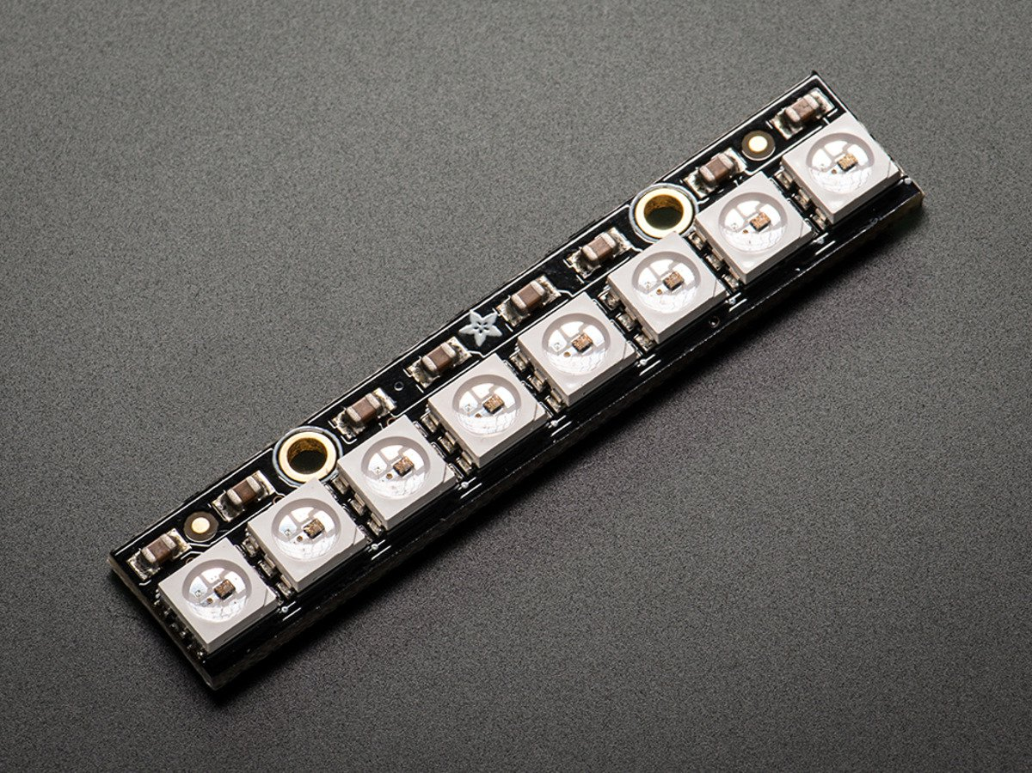
Hardware: Neopixels
Notes:
In addition, I’m using an array of Neopixels for my ‘sky.’ These are addressable RGB leds that can provide a large range of colours and can be controlled independently with a one-wire interface.

Slide 14
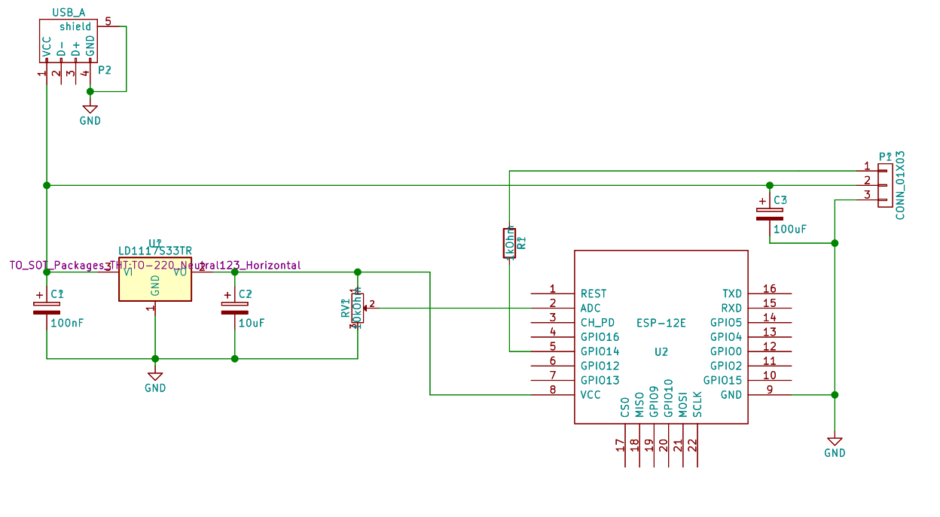
Hardware Schematic
Notes:
The Skylight can run on about 500 mA, and so will be compatible with most microUSB adapters. I also had no problem running it off my laptop’s USB port. An LM1117 voltage regulator is used to drop the 5V input down to 3.3V for the ESP-12. Finally, the brightness knob is connected to the device via the ESP’s single ADC.

Slide 15
Software:
NTP used to Synchronise current time
OpenWeatherMap API is used to get sunrise/sunset times for a current location.
Programmed in Arduino with some additional libraries
Example JSON response:
{"coord":{"lon":139,"lat":35}, "sys":{"country":"JP","sunrise":1369769524,"sunset":1369821049}, "weather":[{"id":804,"main":"clouds","description":"overcast clouds","icon":"04n"}], "main":{"temp":289.5,"humidity":89,"pressure":1013,"temp_min":287.04,"temp_max":292.04}, "Wind":{"speed":7.31,"deg":187.002},"rain":{"3h":0},"clouds":{"all":92},"dt":1369824698,
"id":1851632,"name":"Shuzenji","cod":200}
*http://openweathermap.org/current
Notes:
A large part of the project from a software perspective ended up trying to find a suitable API for getting the sunset/sunrise times. I finally ended up with OpenWeatherMap. With OpenWeatherMap, I could send a get request with the name of the city and country, and get sunrise and sunset times. And I also used a lot from the ESP8266 library for creating connections, setting up a small web and dns server, and creating the access point on first startup.
Questions?

Slide 16
Viability of the Product:
Fulfills the Product Requirements
Cost of Materials was fairly low at $45, could be much lower.
Few security / privacy concerns
Lots of room for expansion
Pros
Notes:
So I’d like to take a moment to talk about the viability of this product. In my opinion, the product is viable. It fulfills the requirements I had at the beginning of the project. It takes sunrise and sunset times and visually simulates them in a pleasing way. The cost of materials ended up being under fifty dollars, but it could be much much lower. I ended up purchasing a lot from Creatron, and I think the cost could easily be under $15. I’d also like to discuss security concerns, since they are rightly a very important issue for IoT devices. It was an intentional choice for me that the Skylight have little in the way of input. The Skylight uses GET requests, which are not secure, but the only thing communicated is your home city. The only sensitive information that the Skylight stores is your WiFi credentials, but you can only see the web interface if you’ve already connected to your home WiFi, so I believe that the Skylight is quite secure.

Slide 17
Viability of the Product:
Would require more development to be truly scalable
Would require a professional license or a server for API calls.
The enclosure is not what I had in mind.
Cons
Notes:
However, there are some concerns if this were to become a commercial product. At the moment, the home location is hard-coded as well as the timezone. Implementing this dynamically was going to require yet another API and would also require some error handling to deal with many cities with the same name. I wasn’t willing to do this, so I left it hard-coded. In addition, Openweathermap places some restrictions on how their API is used. So if this were a commercial product, it would probably make sense to create your own server and have the Skylights send their requests there.

Slide 18
Future Developments:
Simulate some weather: cloudy, sunny, thunderstorms.
Create themes: fireplace, aquarium.
Repeatable alarms
Change the temperature of the light: F.lux for your bedroom
Implement Android/iOS apps
Connect to MQTT for subtle notifications
more..!
Feel free to suggest your own
Notes:
In terms of future developments, I think there are a lot of ways you could expand on this functionality without even changing any of the hardware. Here are some of the ideas that I brainstormed:

Slide 19
Project Skylight
A Smartlamp Providing Clarity
Eric Brauer
eric.m.brauer@gmail.com
Notes:
I would be glad to take any questions you might have.

